Slide 1
Screening Tools for addressing Post-Partum Opioid Misuse
Notes:
Jenn

Slide 2
Best practice for primary care integration
SBIRT
Screening
Brief
Intervention
Referral
To Treatment
Notes:
Diana

Slide 3
Why is SBIRT important?
Risky substance use is a health issue that often goes undetected.
SBIRT is an:
Evidence-based approach to identify patients who use alcohol and other drugs at risky levels
Goal of SBIRT:
reduce and prevent related health consequences, disease, accidents, and injuries
Notes:
Diana

Slide 4
Screening, Brief Intervention, and Referral to Treatment (SBIRT) model overview
Screening
Low Risk
Moderate to High Risk
Severe Risk, Dependency
Moderate Risk
No Further Intervention
Brief Intervention
Brief Treatment
Referral to Specialty Treatment
Notes:
Diana

Slide 5
Screening Tool Table
Includes 7 high-quality, effective screening tools to choose from
Factors to consider:
Length/Time
Self-Administered versus In-Person Interview
Average Patient Age
Valid/Accurate
Language
No “right” or perfect tool
Notes:
Jenn
The screening tools listed in the job aid are all high quality and effective instruments. We have identified these seven tools below based on evidence, accuracy, culture competency, availability, and ease of use. However, some are more valid with certain populations, including pregnant and post-partum women and those for whom English is their second language. In deciding what tool to use and incorporate into your practice, we provided more details about the following characteristics:

Slide 6
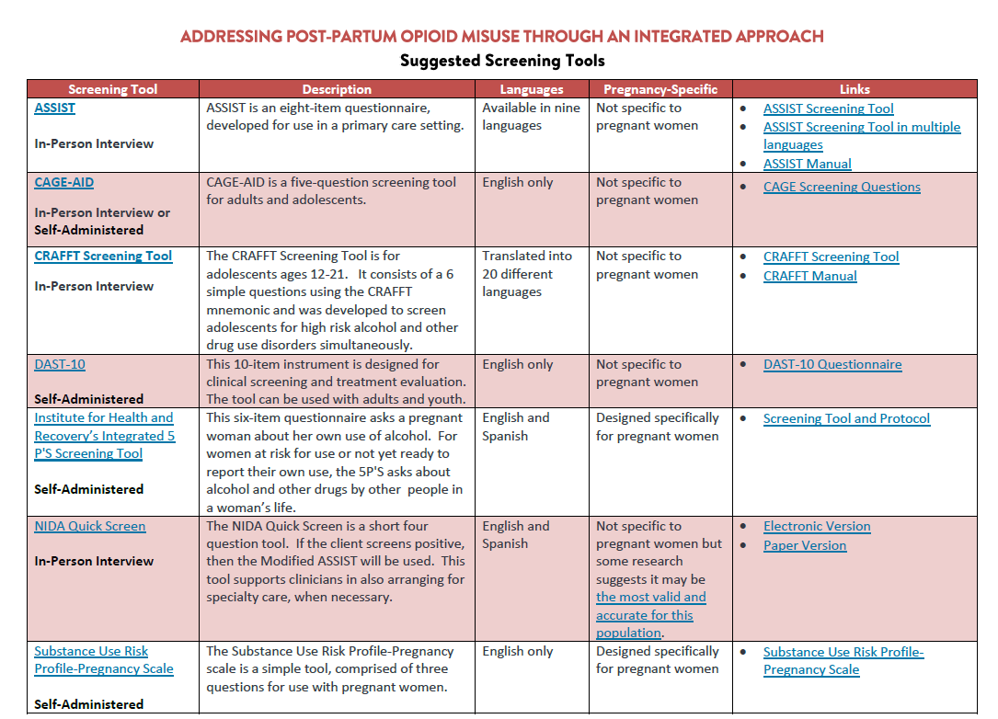
Notes:
Jenn: Give Overview of Layout/Format

Slide 7
ASSIST
8 item questionnaire
Alcohol, Smoking and Substance Involvement Screening Test
Developed to be culturally neutral
Available in 9 different languages
Developed for primary care settings
Takes 10 minutes to administer
In public domain
Endorsed by the World Health Organization

Slide 8
CAGE-AID
Cut down, Annoyed, Guilty, and Eye-opener -Adapted to include drugs
4 question screen
English-only
Used with pregnant and post partum women but it has not been validated for this population
Focuses on heavy drug and alcohol use and may miss light or risky use.

Slide 9
CRAFFT
Developed for adolescents
Car, Relax, Alone, Forget, Friends and Trouble
Six questions
Providers ask the questions
Developed and validated in English and Spanish
Takes 5-8 minutes to administer

Slide 10
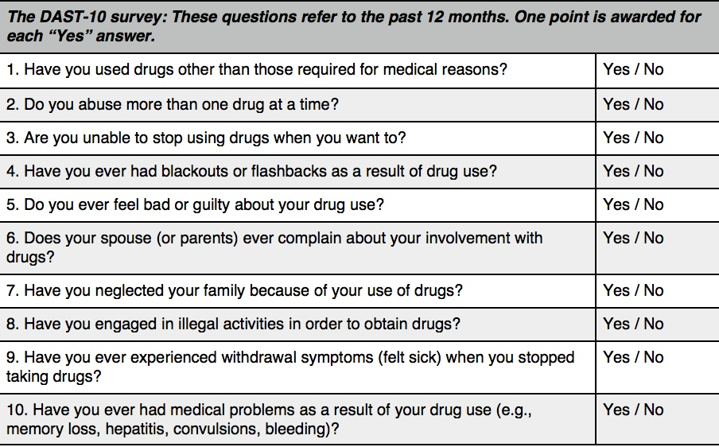
DAST-10
10-item, yes/no self-report instrument
Drug Abuse Screening Test
Takes 5 minutes to administer
Used with adults and older youth
Separate tool for adolescents
English language only

Slide 11
5 P’s
Tested with pregnant women
8 questions including: parents, peers, partner, past and present
Captures light to heavy use of alcohol and drugs
In public domain
English language only
5-8 minutes to administer

Slide 12
NIDA Quick Screen
One of the most accurate screening tools
National Institute of Drug Abuse
Print and electronic screens available
Guides clinicians through a series of questions to identify risky substance use in their adult patients
Translated and validated in Spanish and English
2-10 minutes
3 questions

Slide 13
Substance Use Risk Profile – Pregnancy Scale
3 Questions
Tested with pregnant women
Captures light to heavy use of alcohol and drugs
English only
2 minutes to administer

